Slide 1
Forex
Track and Optimize for All Digital Marketing Channels

Slide 2








Do you know how customers find you?
Tracking: 82.2% of performance marketers do not have
the ability to measure cross-channel performance or return
on investment. Do you track your customers’ journey?
Attribution: $137.5 billion is spent on digital advertising.
Do you know the ROI of every dollar you’ve spent?
Optimization: Forex digital marketers can spend upwards of $800 to acquire each new user. Do you know which channels your customers interact with before they decide to buy?
Search
Affiliate
Display
Social
Engagement
Video
Mobile
Shopping

Slide 3
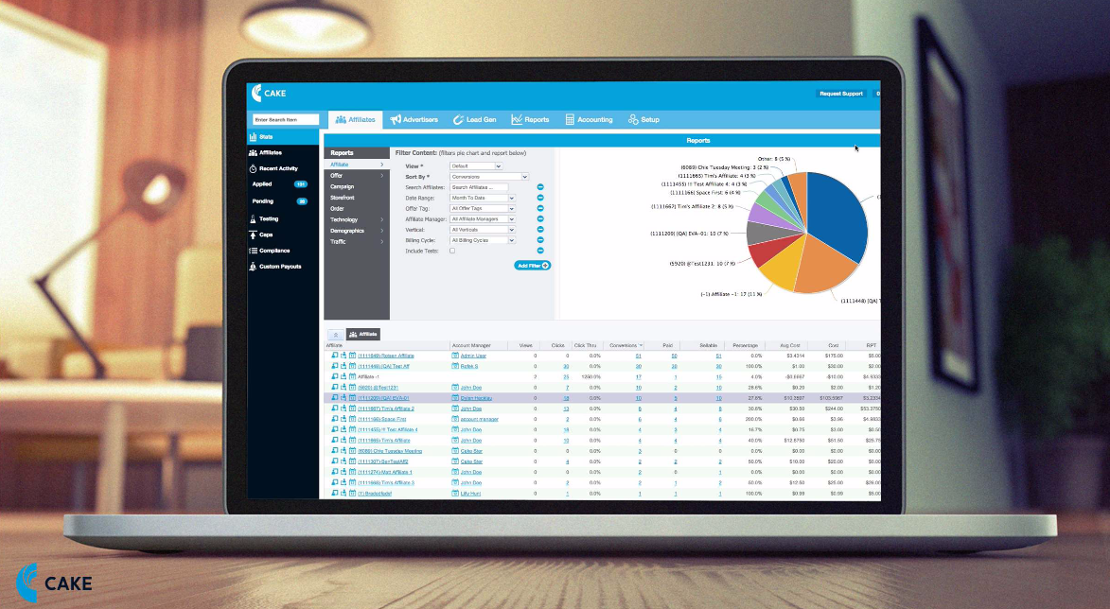

How can you get the most MONEY from your lead flow?
Acquisition Marketing
Email

Slide 4
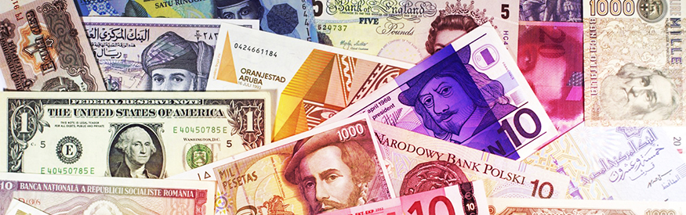
See clearly, spend better
CAKE’s intuitive SaaS-based platform provides tracking,
attribution and reporting clarity, allowing forex marketers to optimize the performance of their digital spend.
Our platform captures and analyzes granular data to
attribute every customer action, pinpointing the digital channels that are the most valuable traffic sources. With this business intelligence, forex marketers can increase online sales and lead generation.

Slide 5






A single system manages all digital channels:
Multi-channel tracking in real-time covers search, display, email, social, mobile, video, affiliate, direct, shopping and more
Robust reporting structure yields deep insight into the channels that drive digital marketing campaigns
Single-view dashboards let you easily decide where to spend your digital marketing budget
Diverse integrations work with over 60 technology and service partners
Proven reliability facilitates over 5 billion consumer transactions per month
Intuitive data visualizations provide the ability to make intelligent marketing decisions

Slide 6




CAKE Manages Your Forex Digital Marketing Needs
Enable direct relationships with affiliates
Free yourself from costly large network transaction fees
Get better payouts, more transparency and insight into traffic quality
Elevate and grow revenue from affiliates, a key channel in currency trading

Slide 7




CAKE Manages Your Forex Digital Marketing Needs
Track each step in the customer journey with event-based tracking
Evaluate the customer lifetime value driven by your affiliate marketing efforts
Know when customers take actions like create an account, execute trades, download content, and more
Easily see which affiliates are driving the most valuable traffic

Slide 8




CAKE Manages Your Forex Digital Marketing Needs
Work in multiple languages and currencies
Integrate with networks, DSPS, suppression, fraud and mobile partners
Get 24/7 support from our offices around the globe
Ramp up quickly with customized training and dedicated account managers

Slide 9
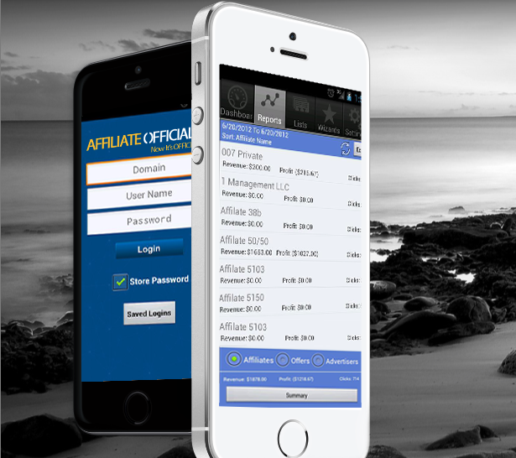
“A better understanding of the relative value of each source of traffic helps us make better decisions about commission rates and identify and reward the most successful affiliate marketing strategies. This level of insight is just not possible with less sophisticated solutions.”
Aaron McNeal
CTO and Co-founder
Affiliate Officials/Currency House

