Slide 1
Retail and Ecommerce
Track and Optimize for All Digital Marketing Channels

Slide 2










Do you know how customers find you?
Search
Affiliate
Display
Social
Engagement
Mobile
Video
Shopping
Notes:
Tracking: 82.2% of performance marketers do not have
the ability to measure cross-channel performance or return
on investment. Do you track your customers’ journey?
Attribution: $137.5 billion is spent on digital advertising.
Do you know the ROI of every dollar you’ve spent?
Optimization: Digital interactions influence 36 cents
of every dollar spent in retail stores, totalling $1.1 trillion
annually. Do you know which channels your customers
interact with before they decide to buy?

Slide 3
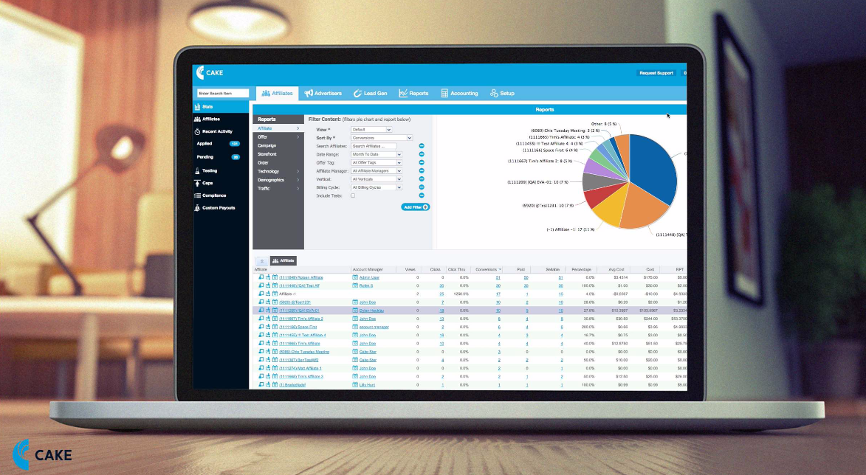

How can you get the most MONEY from your lead flow?
Acquisition Marketing
Email
Notes:
CAKE’s intuitive SaaS-based platform provides tracking,
attribution and reporting clarity, allowing online retailers to
optimize the performance of their digital spend.
Our platform captures and analyzes granular data to
attribute every customer action, allowing online retailers
to pinpoint the digital channels that are the most valuable
traffic sources. With this business intelligence, online
retailers can clarify and optimize their digital marketing
spend to increase online sales and lead generation.

Slide 4






A Single System Manages All Digital Channels:
Multi-channel Tracking
Diverse Integrations
Robust Reporting Structure
Proven Reliability
Single-view Dashboards
Intuitive Data Visualizations
Notes:
Multi-channel tracking in real-time covers search, display, email, social, mobile, video, affiliate, direct, shopping and more.
Robust reporting structure yields deep insight into the channels that drive digital marketing campaigns.
Single-view dashboards let you easily decide where to spend your digital marketing budget.
Diverse integrations work with over 60 technology and service partners.
Proven reliability facilitates over 5 billion consumer transactions per month.
Intuitive data visualizations provide the ability to make intelligent marketing.

Slide 5




CAKE Manages Your Retail & Ecommerce Needs
SKU and Category-based Reports
Voucher Code Support
Network Management
Real Metrics In Real-time
Notes:
SKU and Category-based Reports: Customize reporting by SKU or category and share these views across your organization. Create calculations for each report and share via custom views.
Voucher Code Support: Upload and track unique coupons by source using advanced attribution options.
Network Management: Manage an entire performance marketing program with one tool to track and analyze results, provide creative and guide digital marketing spend choices.
Real Metrics In Real-time: See exactly which channels are performing, export data to a CSV fi le, access data via API and schedule specific reports.

Slide 6




CAKE Manages Your Retail & Ecommerce Needs
Ecommerce Integrations
Pixel and Postback Management
Multiple Price Formats
Targeted Campaign Control
Notes:
Ecommerce Integrations: Understand every level of ecommerce campaign performance and collect actionable metrics on every order via product feed integration.
Pixel and Postback Management: Simplify workflow and allow administrators and affiliates to control postback and pixels within virtually any network or platform.
Multiple Price Formats: Set price formats by campaign for each conversion or event to track marketing costs across channels by CPA, CPM, CPC or revshare.
Targeted Campaign Control: Get immediate campaign control through real-time optimization of location, device and custom targeting with traffic caps and redirects.

Slide 7


“We selected CAKE as it offers us an innovative and effective ecommerce solution for tracking, attributing and reporting on the performance of our digital advertising campaigns. CAKE will make it possible to understand our customers’ online journey from the first click to the final sale, accelerating our evolution from an advertising model to a full ecommerce experience.”
Fred Dimesa
VP Strategy, Gifts.com

