Slide 1
CAKE for Advertisers
Tracking, Attribution
& Optimization

Slide 2












Introduction
SaaS Marketing Technology Company
Tracking, Attribution & Optimization
450+ Customers
5 Billion+ Consumer Actions per Month
a
a
a
a
a
a
a
a
a
a
a
Notes:
CAKE provides SaaS-based marketing technology solutions for advertisers, publishers and networks.
We specialize in helping advertisers and affiliate marketers with tracking, attribution and optimization.
We have over 450 customers that use our products daily to manage their digital marketing campaigns, including the companies pictured here.
Over five billion customer actions are processed through our products each and every month.

Slide 3

Advertisers’ Challenges
Fragmented Tools
Ambiguous Data
Multiple Systems
Measuring Cross-channel Performance & ROI
Understanding the Customer Journey
  - Touchpoints
  - Marketing Effort ROI
  - Customer Segment CLV
Digital marketing spend will increase by 10.8% over the next 12 months – the highest forecasted growth rate in two years. 98% of global marketers plan to increase or maintain digital spend in that same time frame.
Notes:
The Problem
Marketers are faced with the challenge of implementing and valuating digital campaigns with convoluted, fragmented tools, ambiguous data and multiple systems. This makes it difficult to measure cross-channel performance and ROI. It also makes it difficult for advertisers to understand the customer journey to conversion, including the touchpoints along the way that lead actually lead to conversions, the true ROI of their marketing efforts, as well as the customer lifetime value of their customer segments.

Slide 4
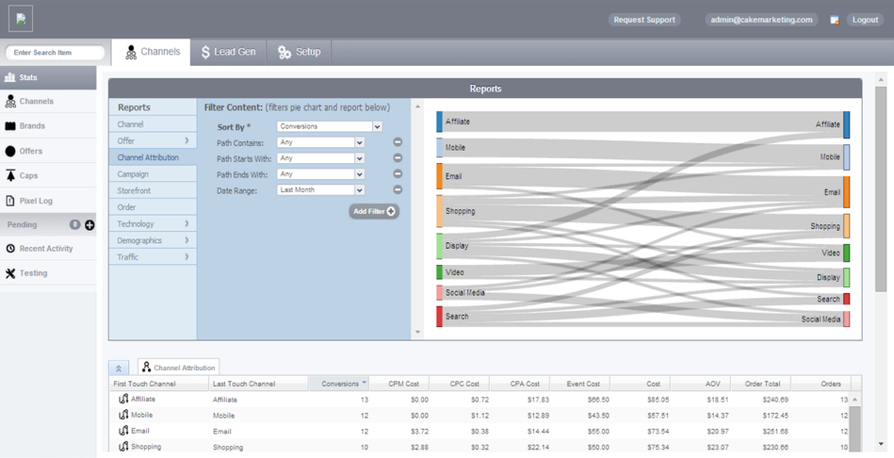
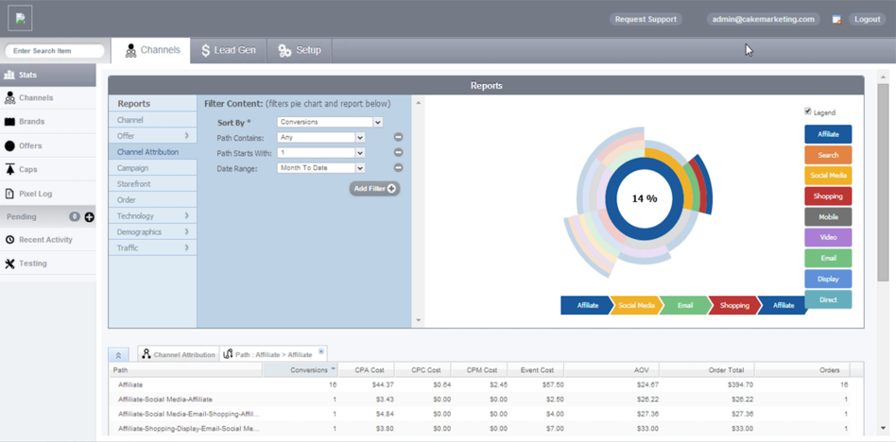
Features
Centralized Multi-channel Tracking and Reporting
Multi-touch Conversion Attribution
Active Management of User Traffic
Targeting
Ecommerce
Lead Generation & Distribution
Notes:
Our Solution
CAKE’s SaaS platform simplifies the performance marketing process. Our intuitive, multi-channel hub allows marketers to track attribution at a granular level, providing unbiased insight into their campaign data, and empowering them to optimize and clarify their digital spend.
Centralized Multi-channel Tracking and Reporting
Get the power and confidence to redirect marketing spend in real-time through deeper insight into the channels that drive traffic.
Multi-touch Conversion Attribution
Support multiple attribution models including engagement, linear, time decay, customized as well as first and last touch.
Active Management of User Traffic
Manage your digital marketing program with one tool, tracking and analyzing results, providing creative, and guiding your digital marketing spend choices.
Targeting
Target by country, language, device, ISP carrier, operating system, browser, or custom parameters using URL and referring affiliate.
Ecommerce
Understand every level of Ecommerce campaign performance and collect actionable data at the product level through product-based tracking and reporting.
Lead Generation and Distribution
Collect, report on, and distribute leads in real-time with industry-leading tools.

Slide 5

Benefits
A Visually Compelling Single Dashboard
    Track and Act in Real-time
    Bring Clarity to Campaigns
    Make Intelligent Marketing Decisions
Notes:
A Visually Compelling Single Dashboard
See your entire digital marketing program in a single, visually compelling dashboard that allows you to:
Track & Act In Real-Time through
• Multi-channel Tracking (Display, Mobile, Aliate and more)
• Multi-touch Attribution
• Automated Performance Alerts
• Targeting
• Partner Integrations & Open API
• Mobile App
Make Intelligent Marketing Decisions through
• Performance Dashboard & Optimization
• Comparative Insights
• Advertiser & Partner Self-Service Portals
• User & Account Management Roles
• Campaign Targeting
Bring Clarity To Digital Marketing Campaigns through
• Detailed Insight & Management Capabilities
• Direct Relationships with Publishers
• Attribution Modeling
• Fraud Monitoring
• Custom Reporting
This allows you to:
• See the entire customer journey from first touch through to conversion
• Understand the True Cost of Marketing Tactics
• Measure the Impact on Customer Lifetime Value

Slide 6

Client Services
Micro-conversion Analysis of Historical Data
Operational Resourcing at a Fixed Cost
Integrations Into Proprietary and 3rd Party Systems
24/7 Account Management and Support Services
Access to CAKE Certified Agency Partners
Notes:
Micro-conversion Analysis of Historical Data
CAKE’s Engagement Attribution Model yields recommendations based on micro-conversion analysis of historical data.
Operational Resourcing at a Fixed Cost
A managed service offering that provides operational resourcing at a fixed cost.
Integrations Into Proprietary and 3rd Party Systems
Product level customizations, integrations into proprietary and 3rd party systems, and advanced professional services on an as-needed basis.
24/7 Account Management and Support Services
Fully realize the benefits of CAKE for Advertisers.
Access to CAKE Certified Agency Partners
CAKE’s Certified Agency Partners offer a number of 3rd party integration solutions, including financial, payout, fraud prevention, call analytics, unsubscribe, info verification and email verification systems.

Slide 7

What’s Next
Understand Your Needs
Demonstrate How CAKE Works for You
Prepare Your Go-Live Plan
Go!
Notes:
We work with you to discover you specific needs.
Then, we setup a demo to show you exactly how CAKE for Advertisers and CAKE’s entire support team will work for you.
We prepare your Go-Live Plan, including making plans with you to go through extensive training on the product with our onboarding experts.
Go!

